Slide 1
Project Gutenberg Analysis
Anna Robinette

Slide 2
Overview
Analysis of 74,896 titles and 70 languages represented
5 major subject categories
Project Gutenberg is entirely digitally distributed
If the corpus were a publisher's’ backlist, what would the market opportunities be?

Slide 3
Performance Metrics
What Makes a
High Performer?
Download Performance
Above 1,000 downloads per title
Consistent performance over time
High relative to catalog share
Market Potential
Large addressable market
Low current penetration
Growing demand indicators
Subject Success
Strong in specific categories
Cross-market appeal
Growth in key segments

Slide 4
Corpus Structure

Slide 5
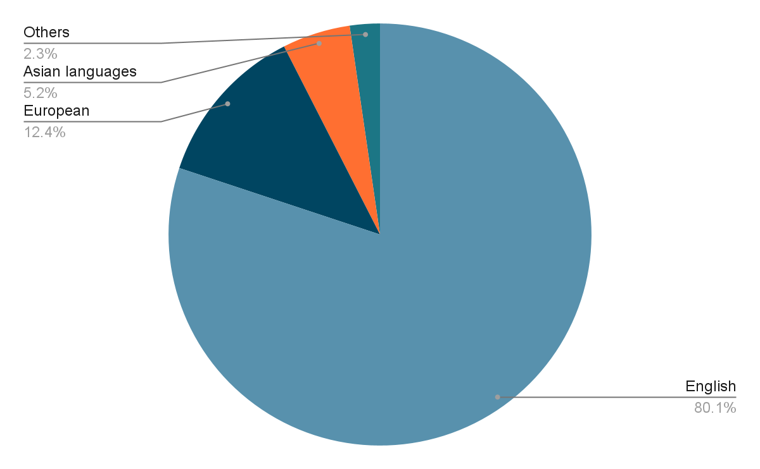
Language Distribution

Slide 6
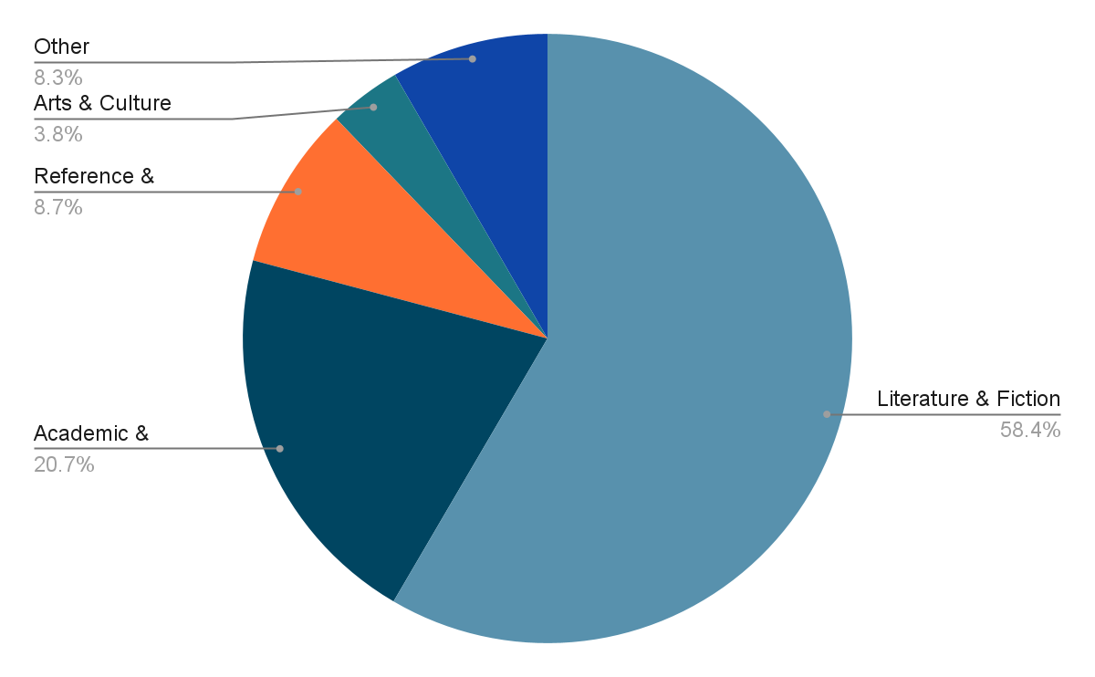
Subject Distribution

Slide 7
High Performers

Slide 8
High Performers
Russian
1,431 downloads/title
56% literature success
0.5% market share
Arabic
1,129 downloads/title
41% educational content
0.1% market share

Slide 9
Emerging Performers
Chinese
938 downloads/title
Strong technical content
Large market potential
Korean
894 downloads/title
Literature focused
Growing demand

Slide 10
Subject Analysis

Slide 11
Top Performing Combinations
Technical Content
German
Chinese
English
Literature
Russian
French
Korean
Educational
Spanish
Arabic

Slide 12
Next Steps

Slide 13
High Performers
Technical Implementation
Digital-first workflow
Content Development
Creating high-quality translations
Distribution Partnerships
Local publishing partnerships
Notes:
### Market Structure
### High performers
1. Russian (1,431 downloads/title)
2. Arabic (1,129 downloads/title)
3. Chinese (938 downloads/title)
4. Korean (894 downloads/title)
5. Romanian (648 downloads/title)
---
##
###

